Slide 1
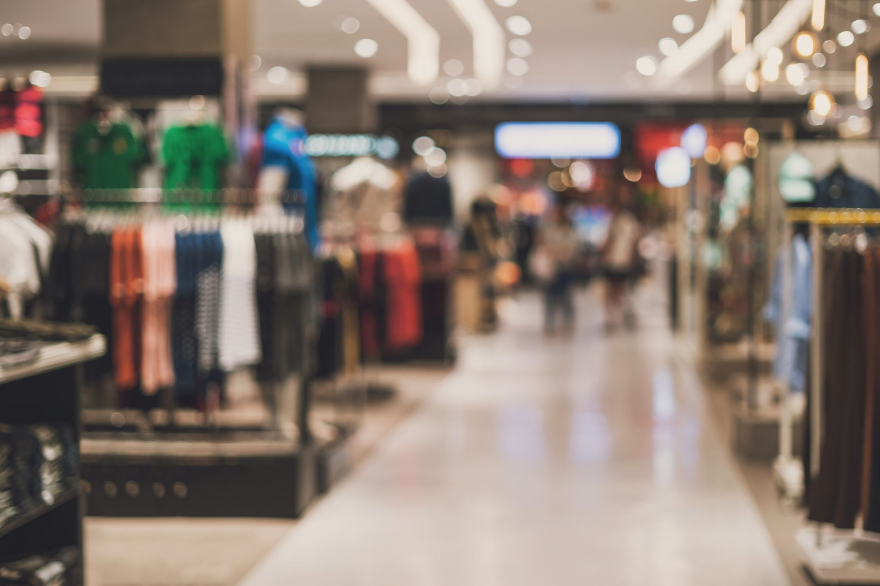
JUST FAB
MKT 6352 - Marketing Web Analytics and Insights
GROUP 10
Denzel Ignatius Arulmani Selvam
Kowshik Raj Durai Murugan
Sanjula Kaul
Guru Prasad Kumar
Sagar Vasantkumar Patel
Sinduja Senthil Kumar

Slide 2

JUST FAB-OVERVIEW
Formerly known as Tech Style Fashion Group.
A leading member-based ecommerce site and lifestyle fashion brand.
Started as Footwear industry has now extended to Apparels and Accessories for Women.
Acquiring and retaining VIP customers is a constant Goal
STATS
Active Members
Over 5.5 Million
50 Retail Stores
Global Reach
- 12 Countries
Social Media
- 11 Million
VIP Members
- Over 2.1 Million
Notes:
While acquiring new VIP members is a constant goal, JustFab had not used direct mail to prospect until reaching out to Epsilon to help them test the channel’s potential for the brand.

Slide 3

Target Customer
FEMALES
Ages 18-49
BUSY
Fashion Conscious

Slide 4
DIVISIONS AND Top Competitors
DIVISIONS | COMPETITORS
JustFab , ShoeDazzle | Zappos, Famousfootwear, Zara
Fabletics | Adidas, Reebok, Under Armour
Savage X Fenty | VictoriaSecret, Thirdlove, AdoreMe
FabKids | The Children’s place, kidpic

Slide 5

BUSINESS OBJECTIVEs and KPI
KPI:
BUSINESS OBJECTIVES:
Increase website traffic.
Improve revenue by identifying shortcomings in visits, AOV and conversion.
Traffic Metrics | Revenue Metrics
Visits | AOV
New and Returning Visitors | Conversion Rate

Slide 6

Analysis

Slide 7
REVENUE WATERFALL ANALYSIS
The graph below shows that there is a decline in Visits, AOV and Conversion, suggesting Revenue has decreased from 2019 to 2020.
Major reason for this decline could be COVID-19.

Slide 8
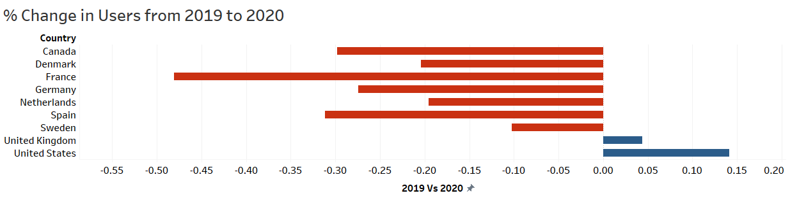
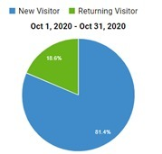
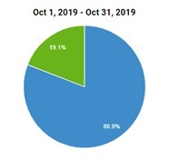
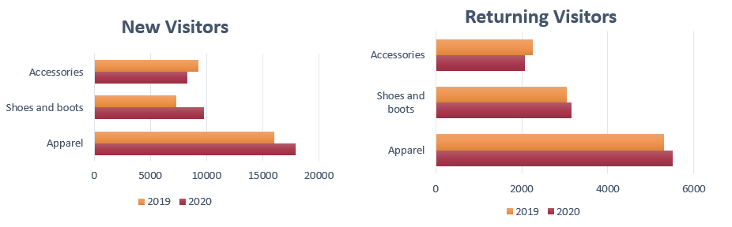
VISITS
Decline in International Market:
There is a substantial decline in the number of users in the international market except United Kingdom and United States.
Visits by Visitor Type:
From the pie chart, it is evident that there is a decrease in returning users from 2019 to 2020.
Visitors Product Preference:
Accessories are facing a decline in Visitors.
It could also be because customers may not be finding value for money when buying Accessories.

Slide 9
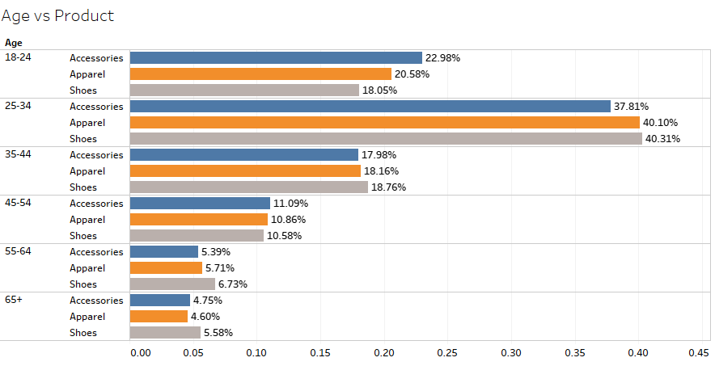
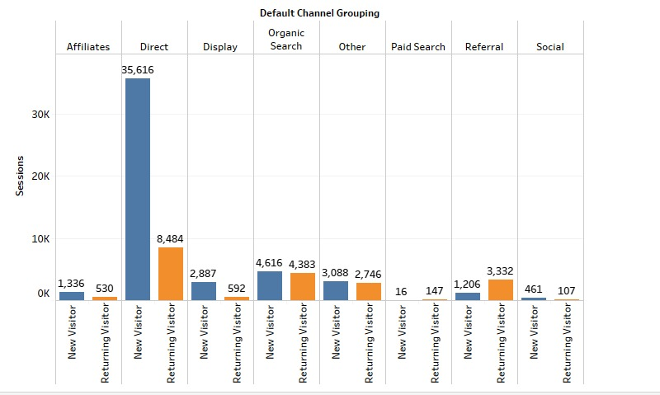
VISITS
Most Active Age-Group: 18-44
Our customers are young and busy. With that in mind, we also need to cater all the relevant age groups, which are: 18-24, 25-34, 35-44.
Effective Marketing Channels:
Direct Search being the most effective marketing channel is losing the most returning visitors.
The most effective channel for returning visitors are referrals from other websites.

Slide 10

How do we increase Visits?
Improve International Market
Addressing preventive measures taken by JustFab during COVID on the website and on other marketing channels can ensure customers in different countries that the deliveries and products are safe to use.
Attract Women of most Age groups
Increasing the range and variety of products that also caters to 18-24 and 35-44.
Increase New Visits
Marketing promotional codes, discounts offered, and safe delivery strategies during COVID by the company using Direct Search for New visitors.
Increase Existing User engagement
Providing more referral codes to the New and Returning visitors.

Slide 11
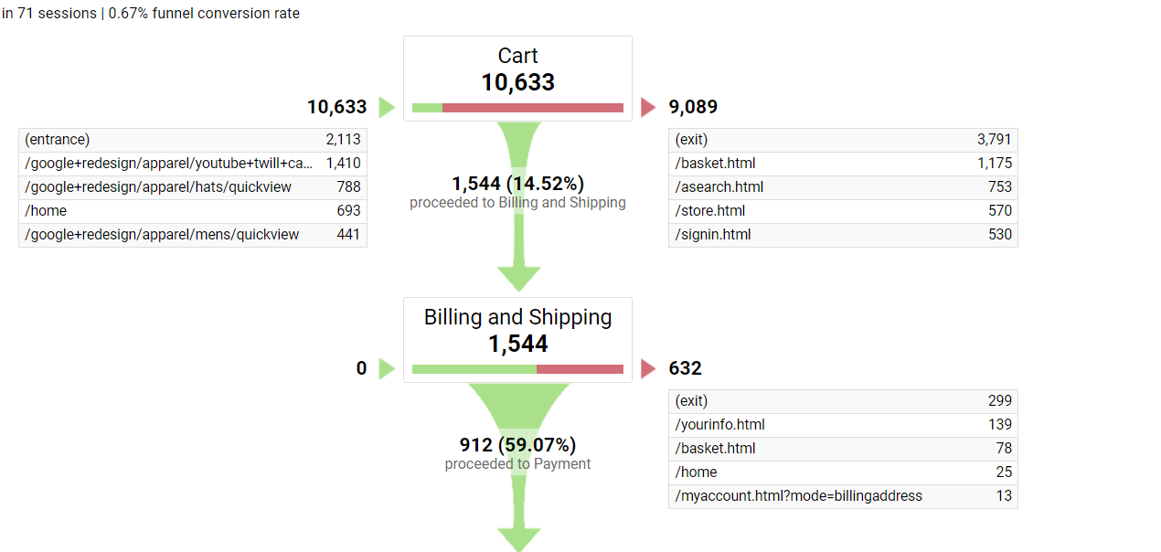
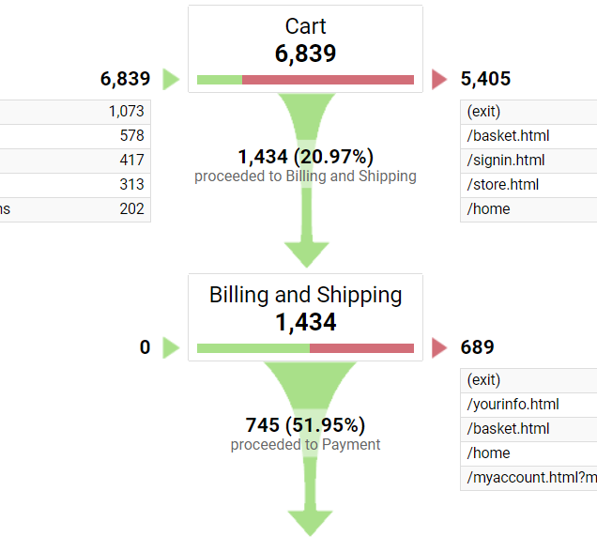
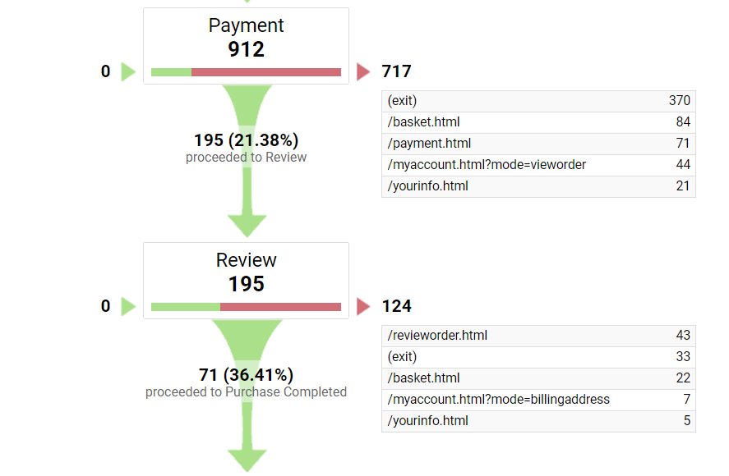
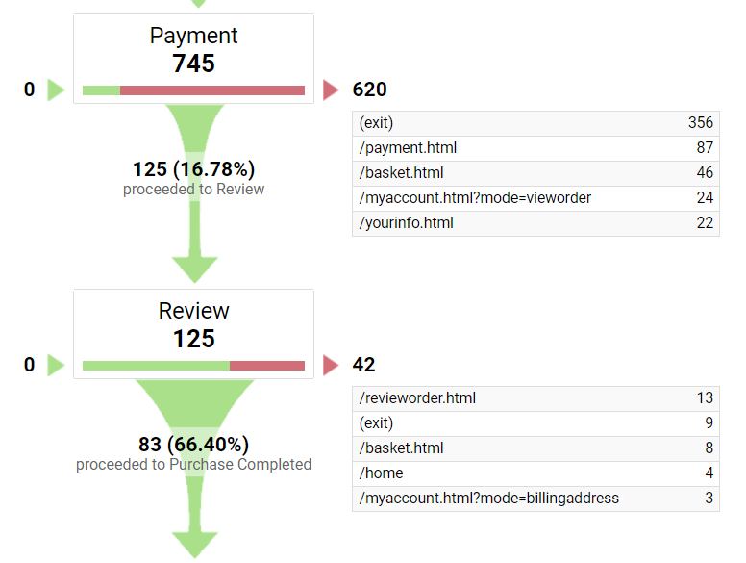
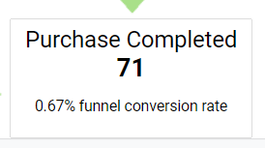
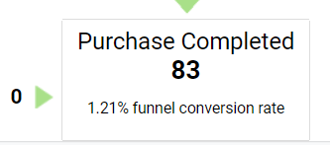
Conversion – Where do we lose our customers?
2020
2019
Between 2019 and 2020, the product collection has improved as it can be seen from the increase in Cart Addition.
A huge drop at Billing and Shipping suggests that people are either losing interest because of high shipping costs.
Losing customers from Payment to Review means that people are finding ways on the website to re-think their decision.

Slide 12
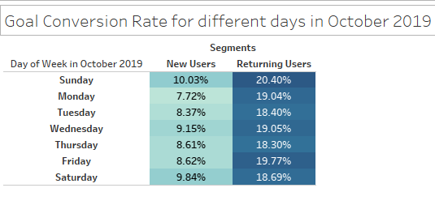
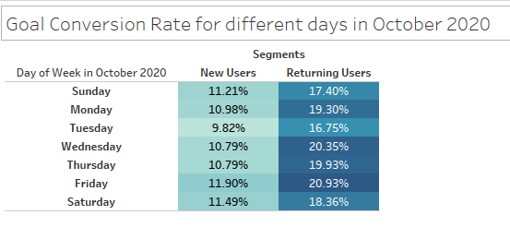
Conversion
Weekend Shopping:
People are more likely to shop in weekends
Loyal Customer Base:
Our existing customers bought more products than new users

Slide 13

How do we increase Conversion?
Promotional Offers:
New Users: Send promotional offers for new users on Friday, Saturday and Sunday
Returning users: Send promotional offers for new users on Wednesday and Friday
Pricing Strategy:
Free shipping for products of high value.
To retain customers’ loyalty and preventing them from moving over to competitors by adopting a competitive pricing strategy.
Optimize Review Page:
To prevent customers from backtracking to the product pages from the review page, we can avoid navigation bars.

Slide 14
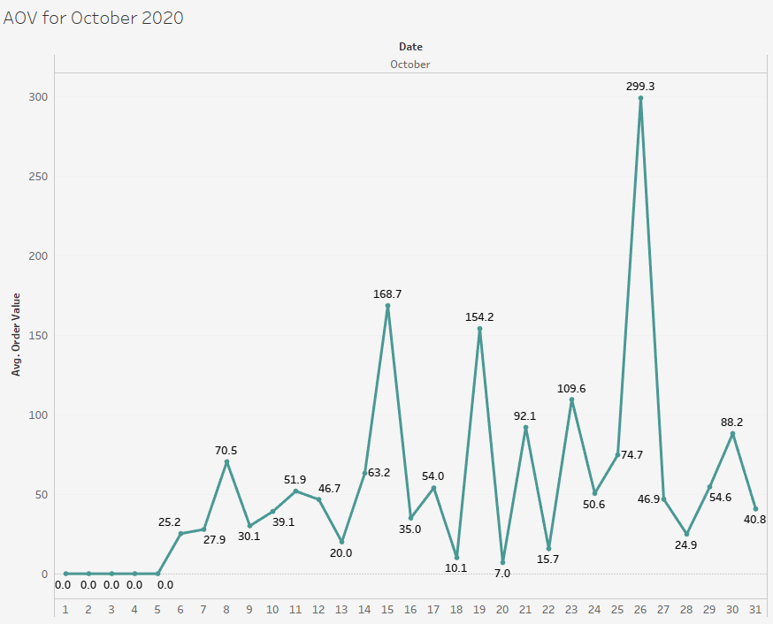
AOV (Average Order Value) – How much is the customer spending on our product
Declining interest in footwear:
We can see a huge drop in the average quantity of footwear purchased and this could be because of our hike in price from 2019 to 2020.
Customer bought more Accessories:
Increase in AOV for accessories could be attributed to the drop in prices from last year.
Price vs AOV:
We can see that the price drop for accessories led to an increase in AOV whereas the opposite was true for other products.
Product Category | 2020 |  | 2019
Product Category | Avg Price | Avg Quantity | Avg Price | Avg Quantity
APPAREL | 31.66$ | 1.23 | 22.14$ | 1.21
ACCESSORIES | 5.08$ | 4.5 | 8$ | 2.67
SHOES AND BOOTS | 19.43$ | 1.25 | 12.92$ | 9.5

Slide 15

How do we increase aov?
Cross Promotional offer: Create product bundle suggestions by combining low-cost products (accessories) with higher cost products (apparel and footwear) to increase the average value of an order.
Promotional offer: Purchase one, get the second one at discounted price

Slide 16
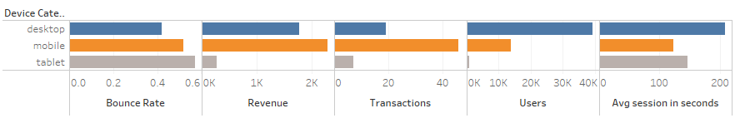
Revenue – By Devices
Device with high revenue:
Mobile users generate the most revenue, but their bounce rate is high and session duration is way less when compared to the desktop users.
Device with high preference:
Desktop users are high and spend more time in our website when compared to mobile/tablet users but buy less.
Device Category | Users | Bounce Rate | Avg session in seconds | Transactions | Revenue
Desktop | 39,371 | 41.95% | 0:03:29 | 19 | $1,770.65
Mobile | 13,654 | 52.00% | 0:02:03 | 46 | $2,291.08
Tablet | 751 | 57.40% | 0:02:26 | 7 | $266.40

Slide 17
Revenue – By increasing user engagement
Page Speed Score: Indicates the extent to which you can improve the load time of a page. A high score indicates less room for improvement. A low score indicates more room for improvement. The score isn't a measurement of speed, but only the extent to which the speed can be improved.
High Bounce Rate – Landing pages:
Our Landing pages have a high bounce rate and almost 3 out 4 times our users do not engage with our pages.
Avg load time/ Page speed score:
On average all our landing pages takes more than 6 seconds to load and have low page speed score values which could explain the high bounce rate.
Landing Pages | Bounce Rate | Avg load time | Page speed score
/home | 74.45% | 7.72 secs | 52
/google+redesign/apparel | 20.00% | 6.72 secs | 41
/google+redesign/shoes | 75.24% | 6.39 secs | 58
/google+redesign/accessories | 74.71% | 6.01 secs | 42

Slide 18

How do we increase Revenue?
Optimize mobile site: Optimize product pages and images in Mobile to improve conversion
Optimizing the landing page: Optimize usability and UX of website focusing on landing pages & search filter.

Slide 19
References
https://nrf.com/blog/how-techstyle-fashion-group-uses-data-drive-growth
https://blog.hubspot.com/marketing/order-review
https://www.justfab.com/how-it-works
https://www.justfab.com/about/story
https://en.wikipedia.org/wiki/TechStyle_Fashion_Group
https://www.consumeraffairs.com/online/justfab.html
https://www.businesswire.com/news/home/20200609005490/en/TechStyle-Fashion-Group-Names-Nina-Fuhrman-Chief-Merchant-for-JustFab-and-ShoeDazzle

Slide 20

THANK YOU GROUP 10 MKT 6352 - Marketing Web Analytics and Insights

